Slide 1
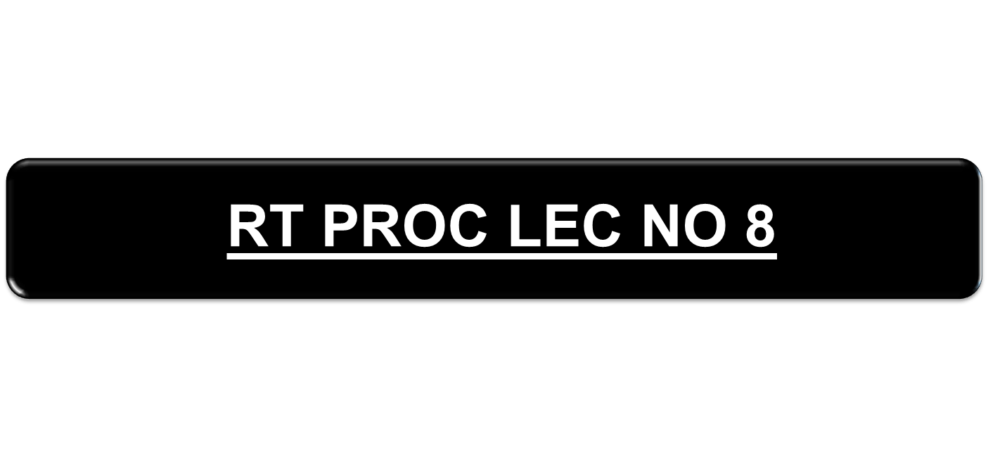

Slide 2

TO ACQUAINT YOU WITH THE PROC OF CHANGING CONT, REPORTING IN NET AND CLOSING DOWN.

Slide 3

1. AT TIMES DUE TO FAILURE OF CONTROL OR DUE TO OPERATIONAL REQUIREMENT THE CONT STN MAY HAVE TO BE CHANGED.
2. IN AN ARMD REGT UNDER THESE CIRCUMSTANCES 2IC OF THE REGT WILL ASSUME CONT AND IF HE ALSO FAILS THEN THE SENIOR MOST SQN CDR WILL ASSUME CONT OF THE NET.
3. AT TIMES THE CO OF AN ARMD REGT MAY NOMINATE ANY OTHER STN AS CONT.
4. IN ADDITION TO THIS THE CONT CAN BE SHIFTED FROM CO TK TO CO ROVER AND VICE VERSA.

Slide 4

1. YOU WILL ASSUME CONT
(a) THIS PHRASE IS USED BY THE CONT WHEN THE CONTROL DELEGATES A PARTICULAR STN TO PERFORM THE DUTIES OF CONT OF THE NET.
2. I AM ASSUMING CONT
(a) THIS PHRASE IS NORMALLY USED BY THE SENIOR MOST OUTSTATION WHEN HE TAKES OVER THE CONT OF THE NET, WHEN THE CONT FAILS.
(b) WHEN THE CONT STN TAKES BACK THE DUTY OF CONT.

Slide 5

+ : HULLO ALL STATIONS SSS CLOSING DOWN FOR FIGURES 30 MINUTES SSS2 YOU WILL ASSUME CONTROL OVER.
SSS : HULLO SSS1 ROGER OVER.
KKK : HULLO SSS2 WILCO OVER.
TTT : HULLO SSS3 ROGER OVER.
KKK : HULLO ALL STNS SSS REPORT MY SIGNAL OVER.
SSS : HULLO SSS1 OK OVER.
TTT : HULLO SSS3 OK OVER.
KKK : HULLO ALL STATION SSS OK OUT.

Slide 6

S24 : HULLO S24 FOR ALL STNS SSS ARE YOU IN COMN WITH CONTROL OVER.
SSS : HULLO SSS1 NO OVER .
KKK : HULLO SSS2 NO OVER.
TTT : HULLO SSS3 NO OVER.
S24 : HULLO ALL STNS SSS ROGER I AM ASSUMING CONTROL OVER.
SSS : HULLO SSS1 ROGER OVER.
KKK : HULLO SSS2 ROGER OVER.
TTT : HULLO SSS3 ROGER OVER.
S24 : HULLO ALL STNS SSS OK OUT.

Slide 7

+ : HULLO KKK I AM ASSUMING CONTROL OVER.
KKK : HULLO KKK ROGER OVER.
+ : HULLO ALL STATIONS SSS I AM ASSUMING CONTROL NOW REPORT MY SIGNALS OVER.
SSS : HULLO SSS1 OK OVER.
KKK : HULLO SSS2 OK OVER.
TTT : HULLO SSS3 OK OVER.
+ : HULLO ALL STATIONS SSS OK OUT.

Slide 8

DSG : HULLO DSG REPORTING IN NET OVER.
+ : HULLO DSG ROGER USE LINK SIGN SSS4 OVER.
DSG : HULLO DSG WILCO OUT.

Slide 9

DSG : HULLO DSG REPORTING IN NET OVER.
+ : HULLO DSG CHALLENGE FIG 01, 04 OVER.
DSG : HULLO DSG WAIT -------------FIG 6543, CHALLENGE FIG 03, 02 OVER.
+ : HULLO DSG WAIT -------------FIG 8736 OVER.
DSG : HULLO DSG OK OVER.
+ : HULLO DSG ROGER USE LINK SIGN SSS 4 OVER.
DSG : HULLO DSG WILCO OUT.

Slide 10

DSG : HULLO DSG REPORTING IN NET, AUTHENTICATION FIG 01, 04 FIG 4208 OVER.
+ : HULLO DSG WAIT -------- OK USE CODE SIGN TKK AND ANSWER AFTER SSS 3 OVER.
TKK : HULLO TKK WILCO OUT.

Slide 11

CODE WORD - RETIRE
+ : HULLO ALL STATIONS SSS RETIRE OVER.
SSS : HULLO SSS1 WILCO OVER.
KKK : HULLO SSS2 WILCO OVER.
TTT : HULLO SSS3 WILCO OVER.
+ : HULLO ALL STATIONS SSS RETIRE NOW OUT.

Slide 12



